Slide 1
Early Diabetes Prediction using Random Forest
Yaswanth Sai Satish Sreerama 11601948
Harshavardhan Reddy Mallannagari 11603389
Varsha Salil 11608680
Preethi Vahitha Sankineni 11607639
Surya Sai Raj Lakkoku 11610081

Slide 2
PROBLEM STATEMENT
Implement a system which diagnoses Diabetes Mellitus after analyzing a person’s health parameters including Age in years, Glucose level in mg/dl, Blood Pressure in mm Hg, Body Mass Index, Skin in mm and Insulin level in one unit/10 gram. A dataset containing these parameters has been provided for training and testing purpose.

Slide 3
ABSTRACT
Diabetes Mellitus commonly known as Diabetes is a metabolic condition that has direct implications on a person’s health and lifestyle. If not detected well in advance it can pose dire long-term threats to one’s well being including cognitive impairment and even death.
While some studies point to lifestyle choices, such as unhealthy diets and lack of exercise, as the main cause leading to this condition, a person’s Genetic makeup has also been proven to trigger Diabetes Mellitus.
The condition is often distinguished by prolonged abnormally high blood sugar parameters, due to the human body’s inability to produce adequate amounts of insulin.
Up until recently Diabetes Mellitus was diagnosed using invasive chemical blood tests, but with the advent of Deep learning and Machine learning, there have been significant developments in diagnosis of conditions like Diabetes Mellitus at early stages. Using Machine learning algorithms like the Random Forest Classifier Algorithm, Support Vector Machines and decision trees, more accurate and precise information regarding the diagnosis on a myriad of domains can be obtained. This in turn will prove beneficial to a variety of research domains.
The project has been implemented to diagnose Diabetes Mellitus from the given health parameters

Slide 4
OBJECTIVE
The dataset used for this project i.e., the PIMA dataset for Diabetes consists of various health parameters like Blood Pressure, Insulin, Glucose levels, Body Mass Index etc., that characterizes Diabetes Mellitus. This dataset has been classified using Machine learning techniques such as the Random Forest Classifier Algorithm, Support Vector Machines and Decision Trees.
The main goal of the project is to generate an accurate system which predicts Diabetes Mellitus by analyzing health parameters such as Age, Glucose levels, Blood Pressure, Body Mass Index, Skin thickness and Insulin levels.

Slide 5
WORKFLOW
Data Exploration
Exploratory Data Analysis (EDA)
Data Manipulation
Feature Selection/Extraction
Predictive Modelling
Project Outcomes & Conclusion

Slide 6
LITERATURE SURVEY

Slide 7
RESULTS

Slide 8
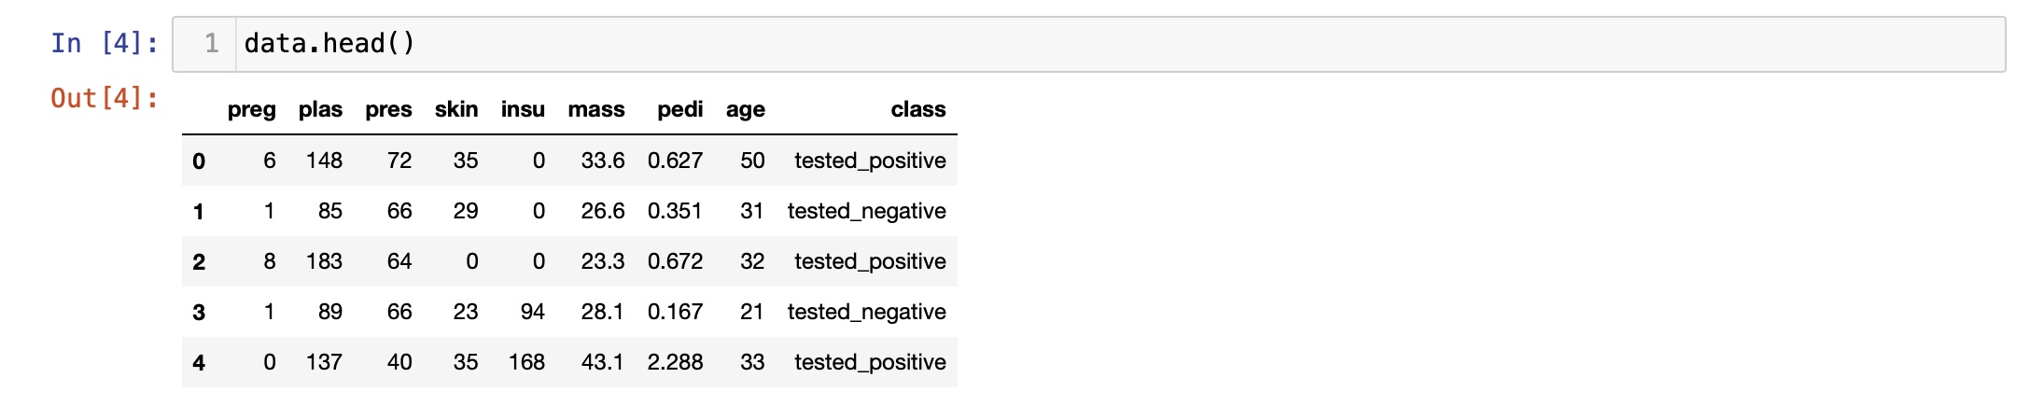

Slide 9
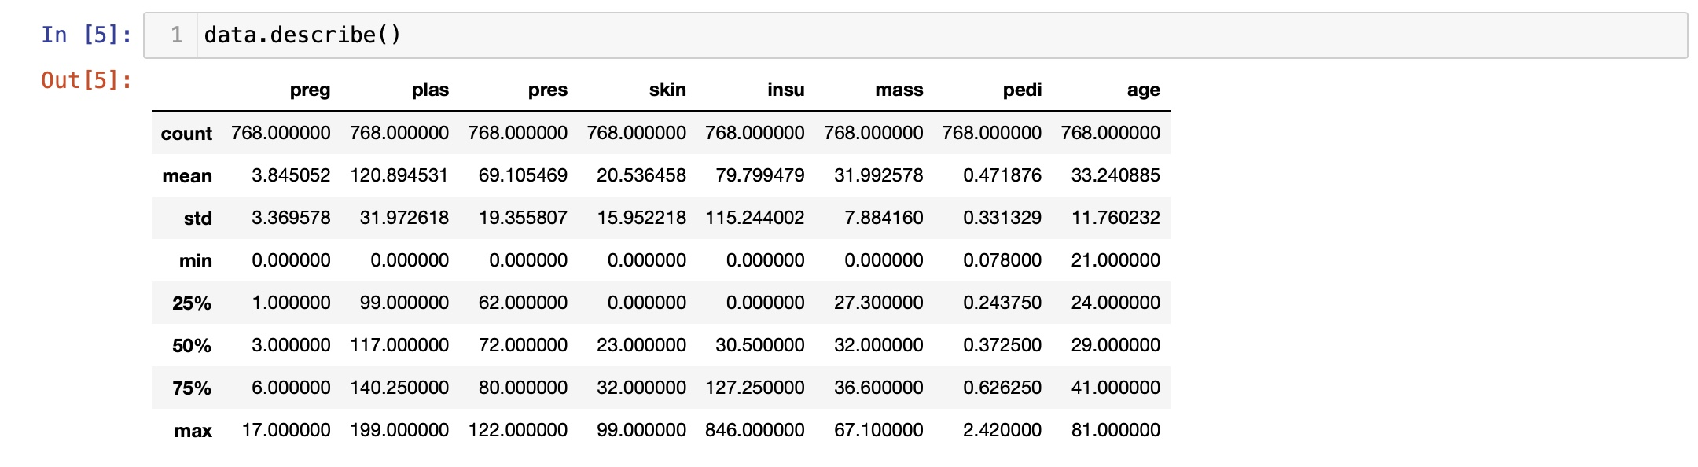

Slide 10
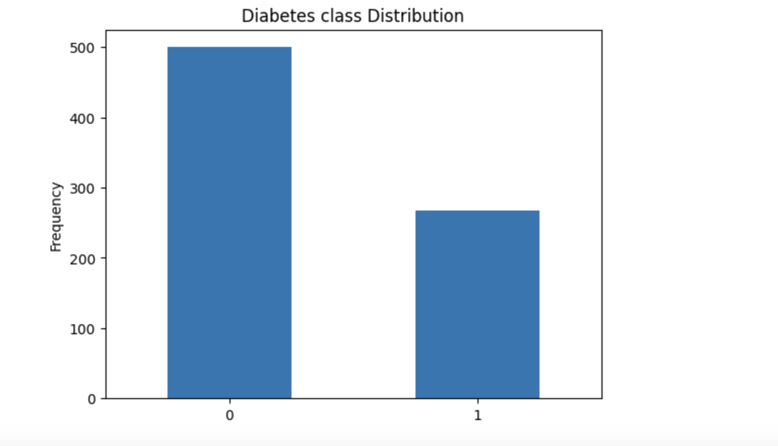

Slide 11
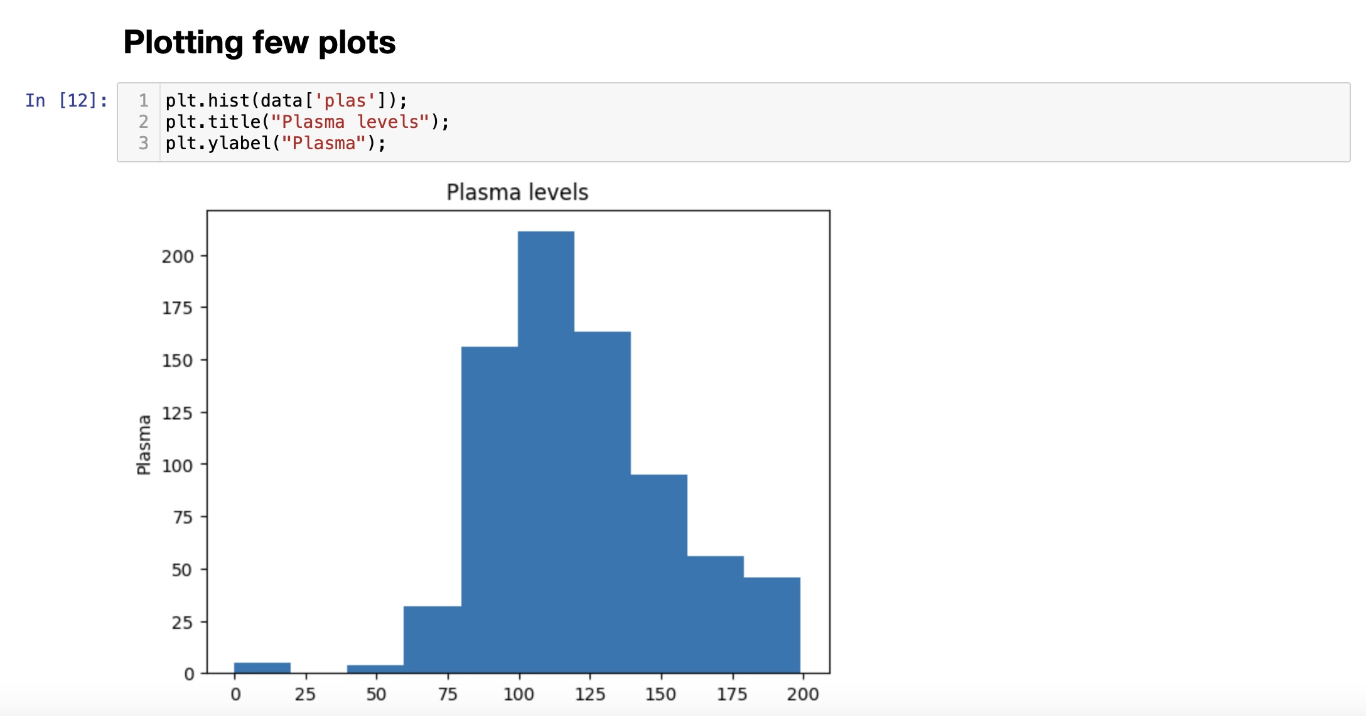

Slide 12
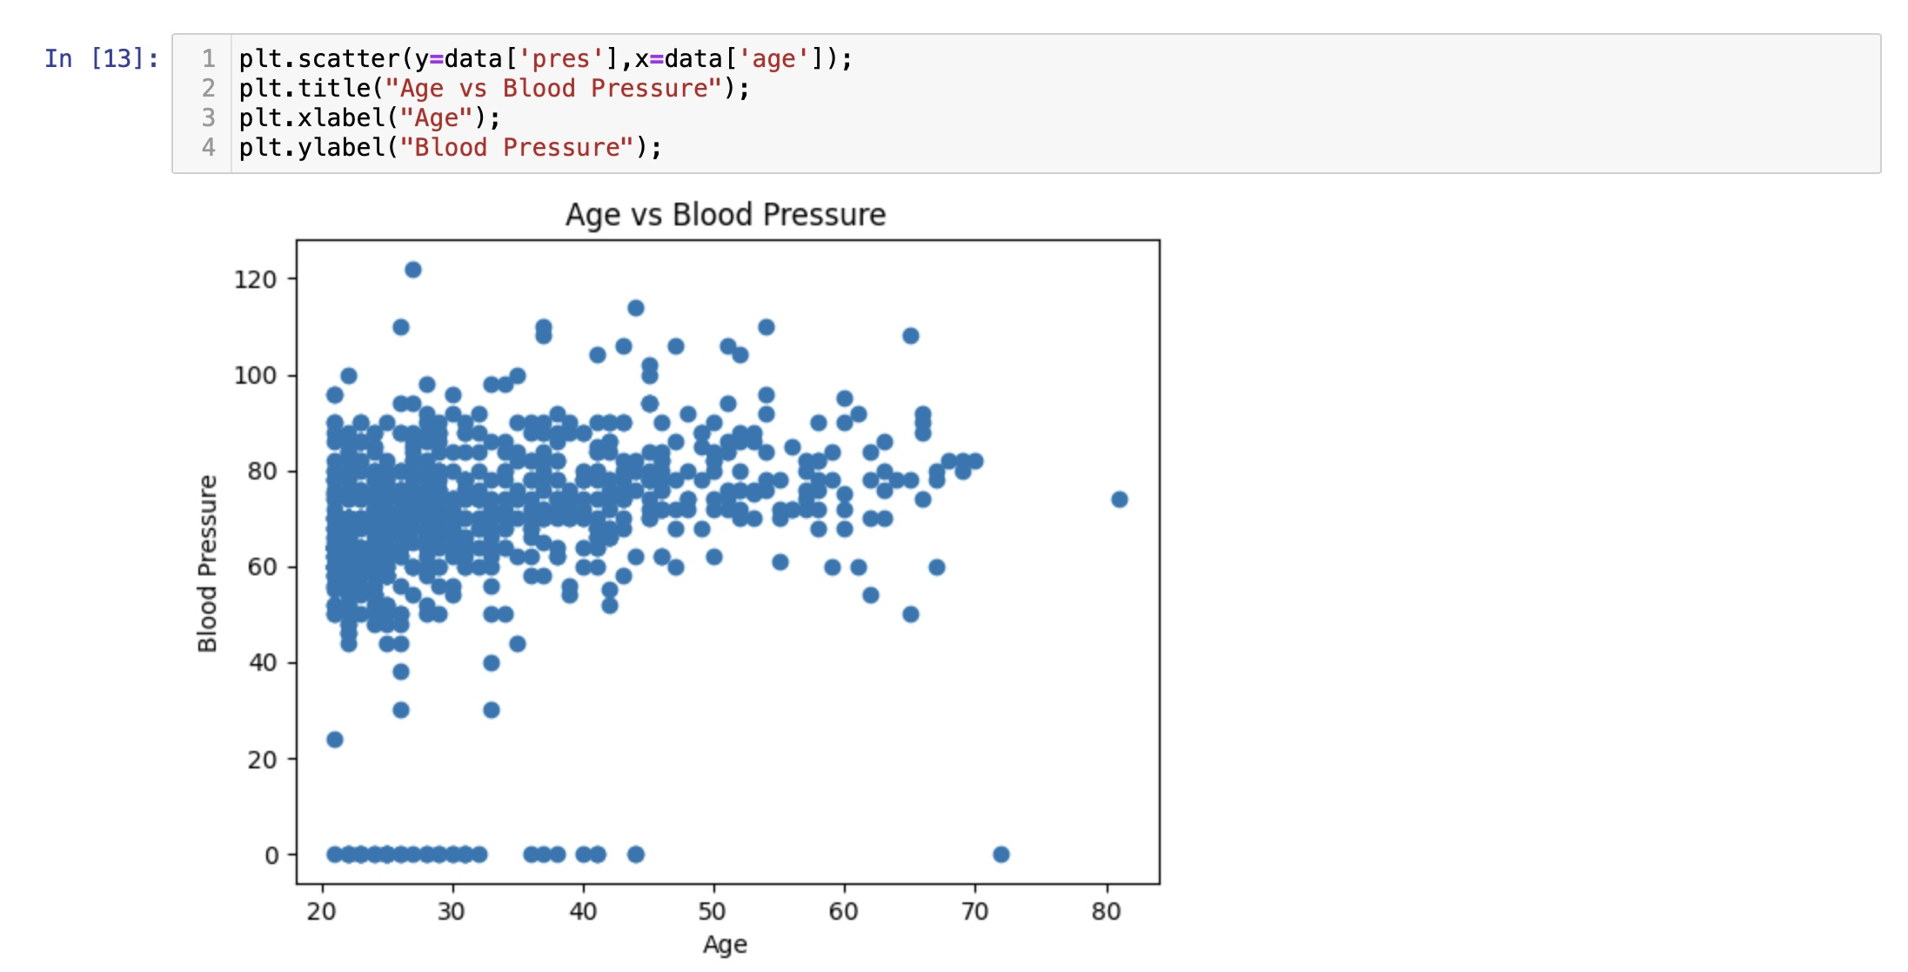

Slide 13
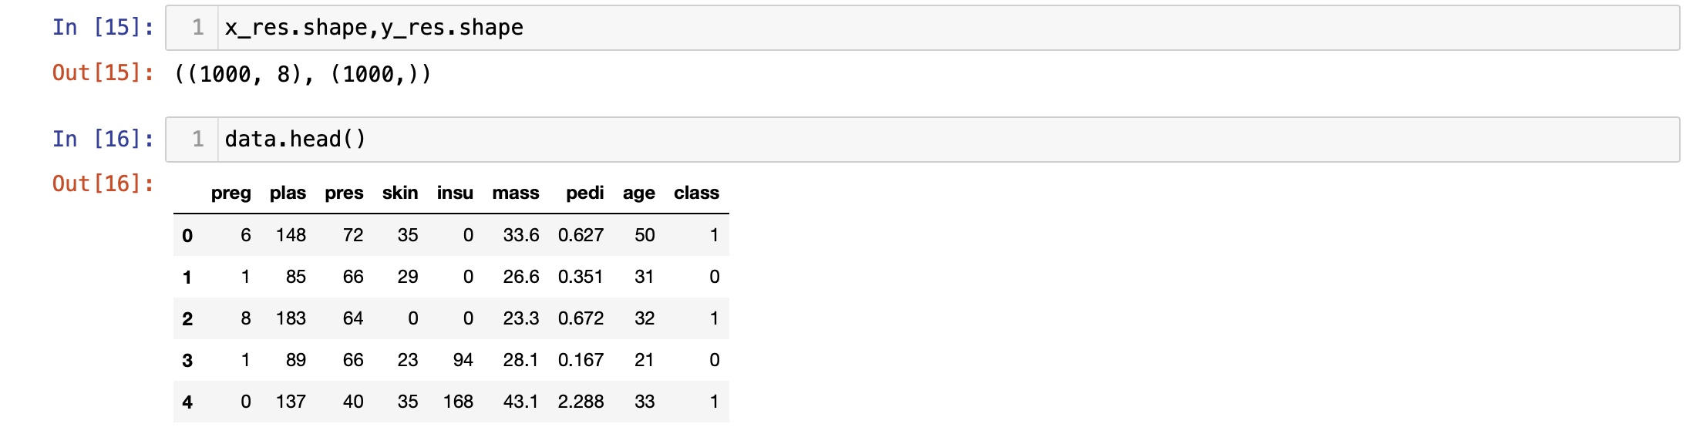

Slide 14
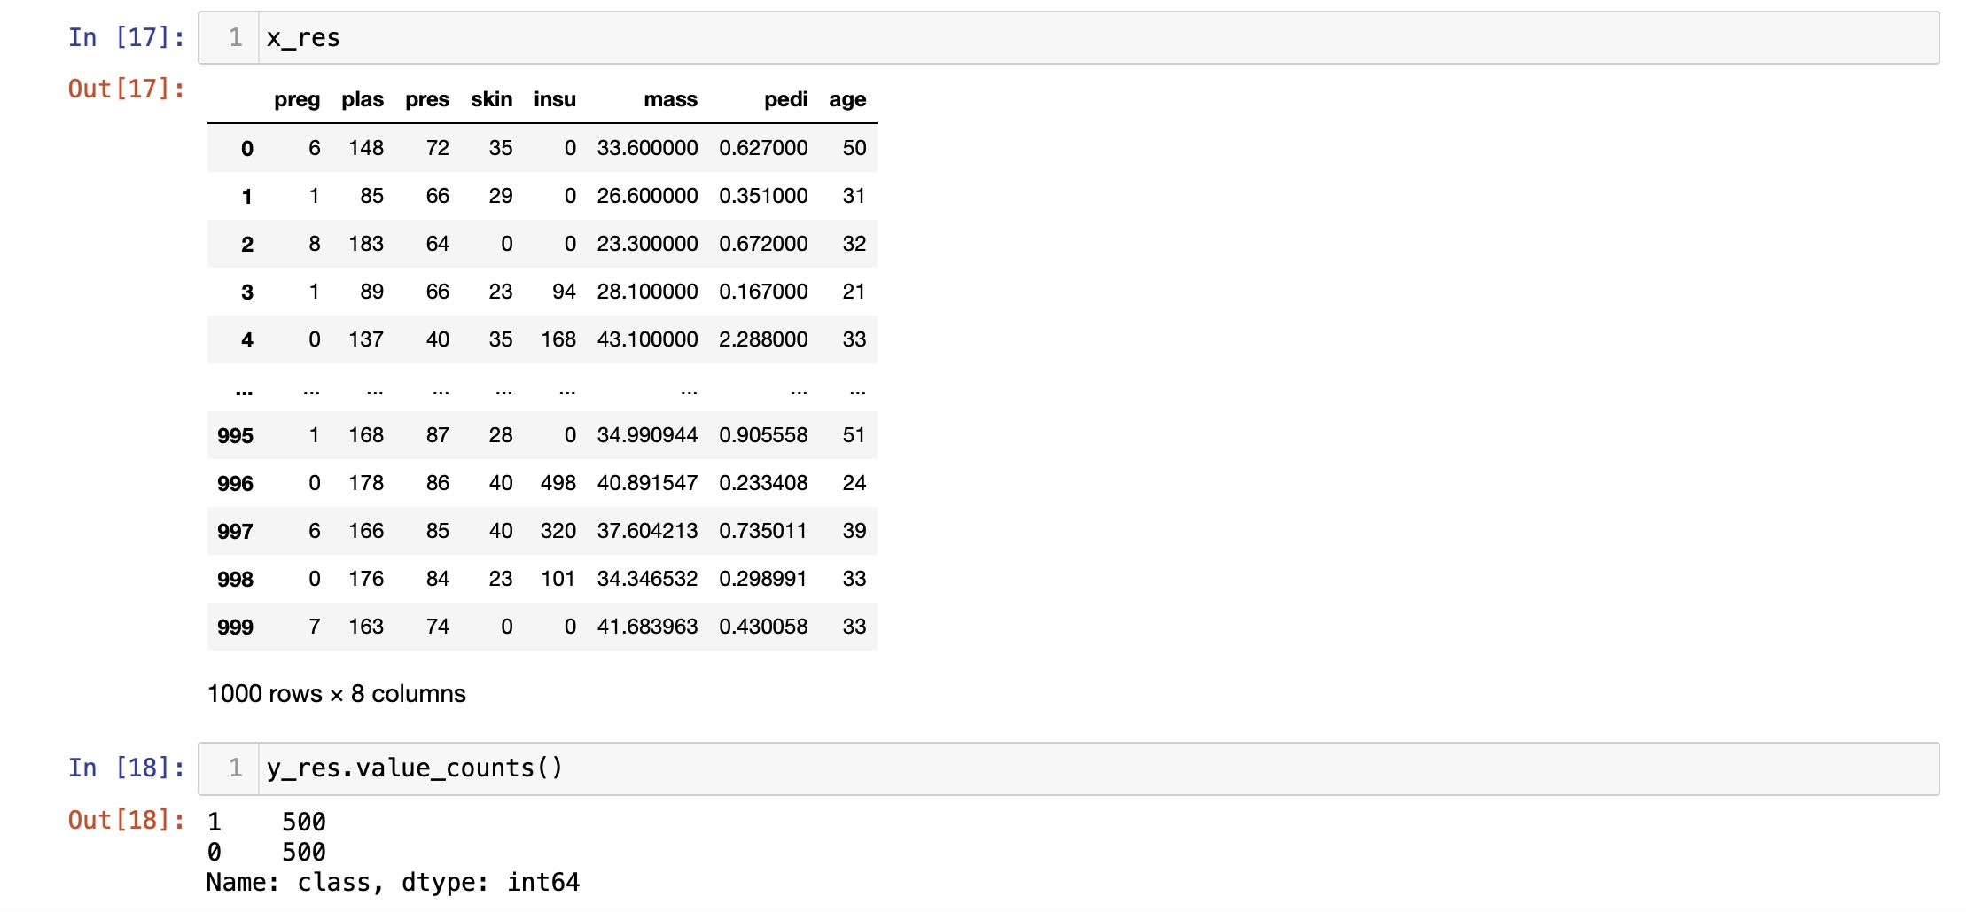

Slide 15
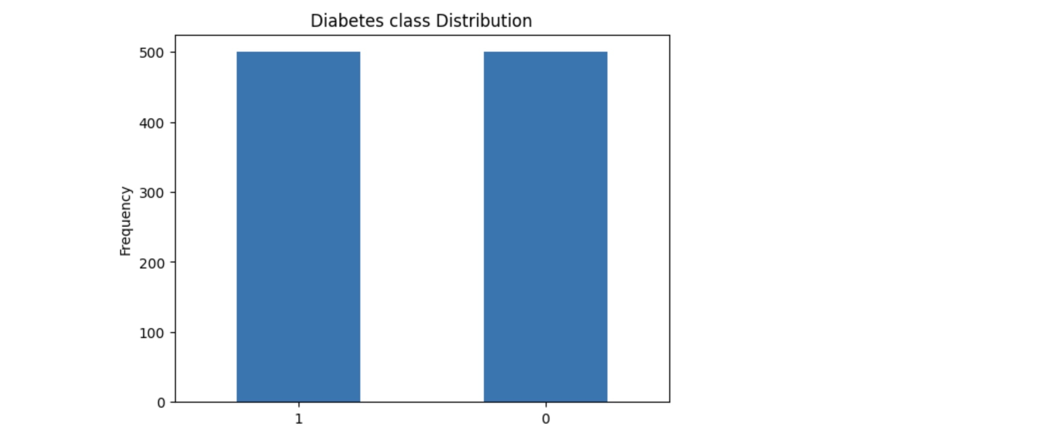

Slide 16
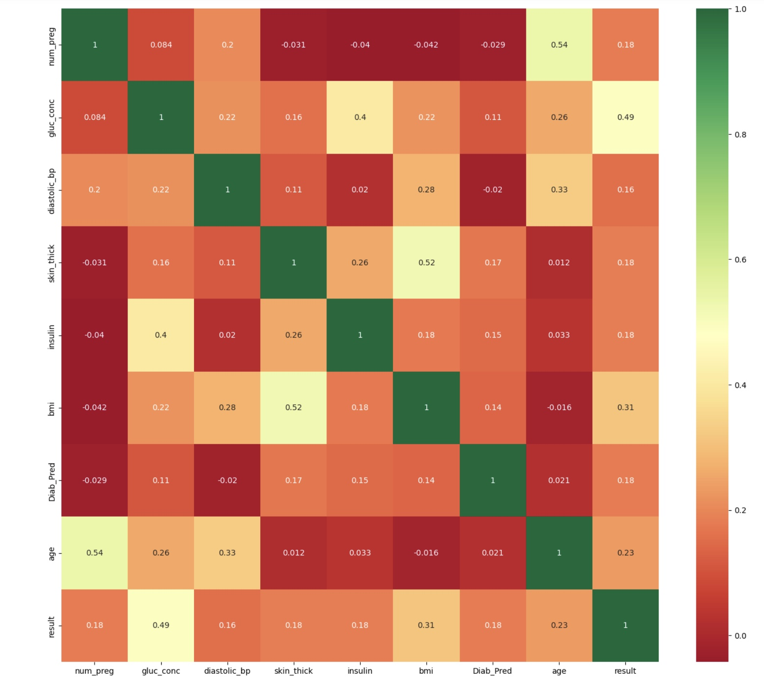

Slide 17
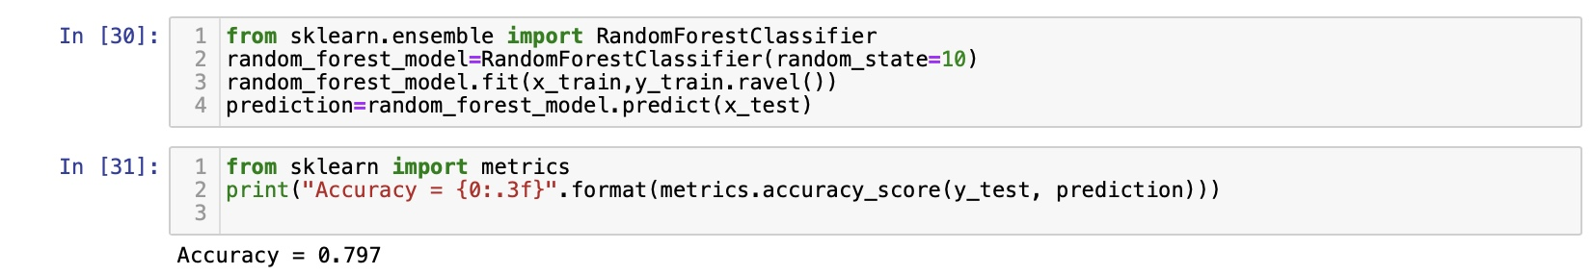

Slide 18
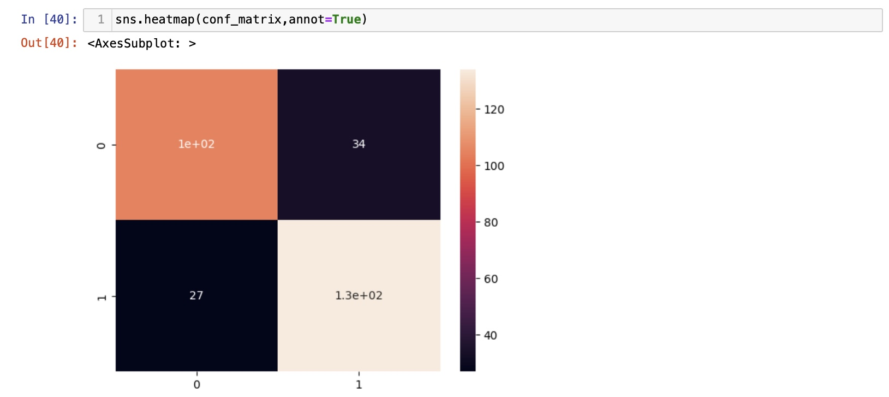

Slide 19
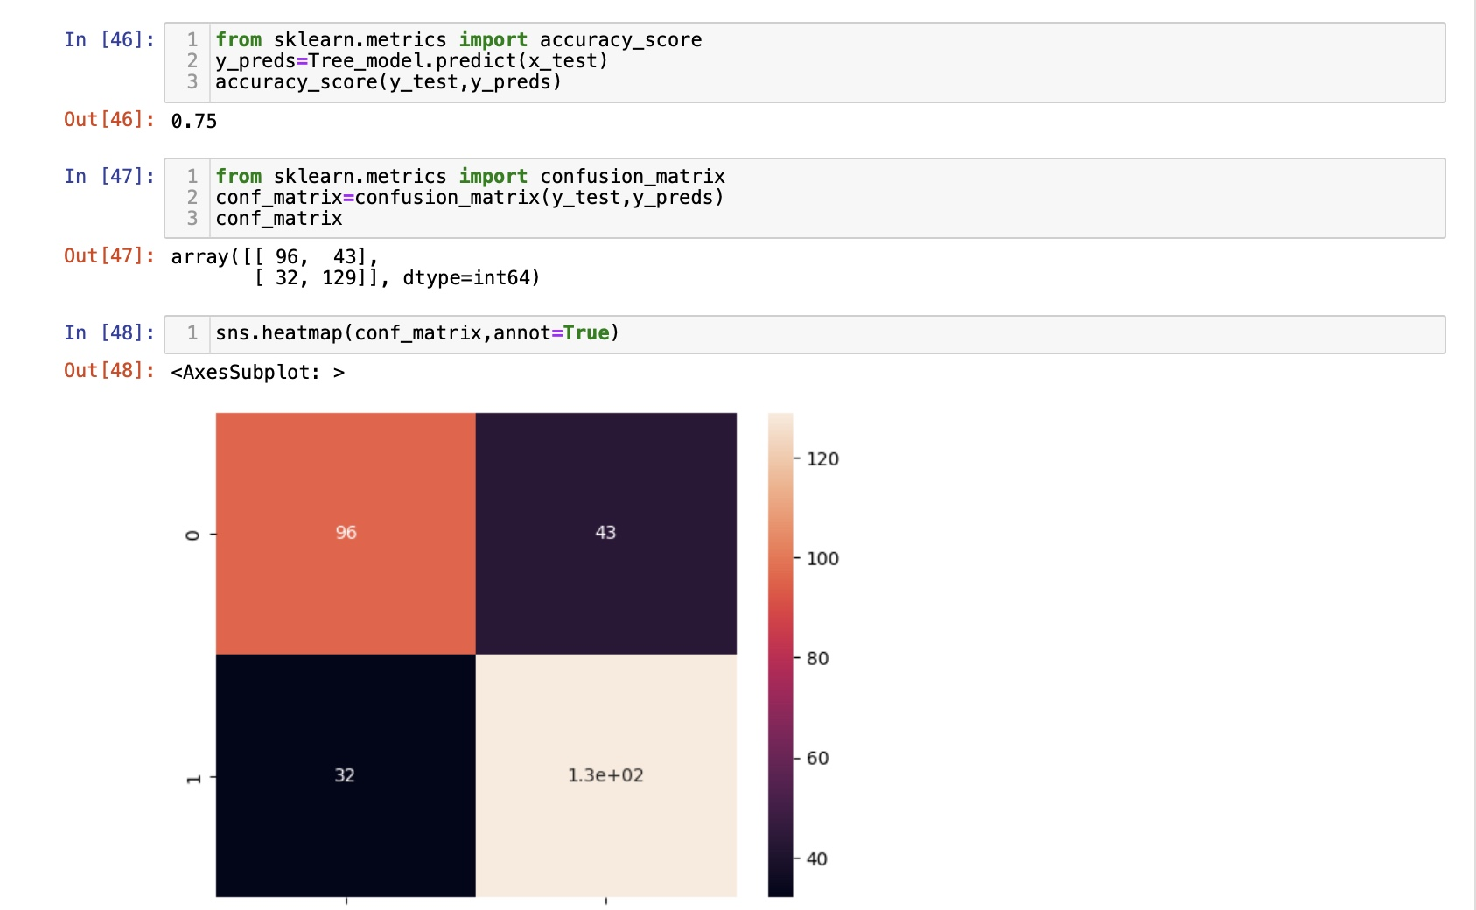

Slide 21
ACCURACY OF THE MODELS
The Random Forest Classifier has been implemented with an accuracy of 79.7%
The Decision Tree Classifier was implemented with an accuracy of 73.3%
Support Vector Machine was implemented with an accuracy of 71%

Slide 22
ADVANTAGES OVER THE EXISTING MODELS
The model provides accurate results for the real time data, unlike the existing methods
The model is devoid of outliers and depends on a weak input case. Hence it exhibits higher reliability and robustness than the existing models
Provides accurate results for already existing Diabetes patients.

Slide 23
LIMITATIONS OVER THE EXISTING MODELS
The model generated cannot completely get rid of the delay between the real glucose level monitoring and continuous glucose monitoring.
Diabetes Mellitus diagnosis does not completely depend on Blood pressure levels alone.

Slide 24
FUTURE SCOPE:
The system can be made compact by utilizing microcontroller components to implement data Transfer.
The efficiency of the project can be increased by taking input from basal bolus therapy, irrespective of the person’s diagnosis.

